Slide 1



Introduction to
Data Analysis in DHIS2
Data Analysis in DHIS2

Slide 2



Welcome to the
DHIS2 Data Analysis course
Notes:
Welcome to the DHIS2 Data Analysis course.

Slide 3
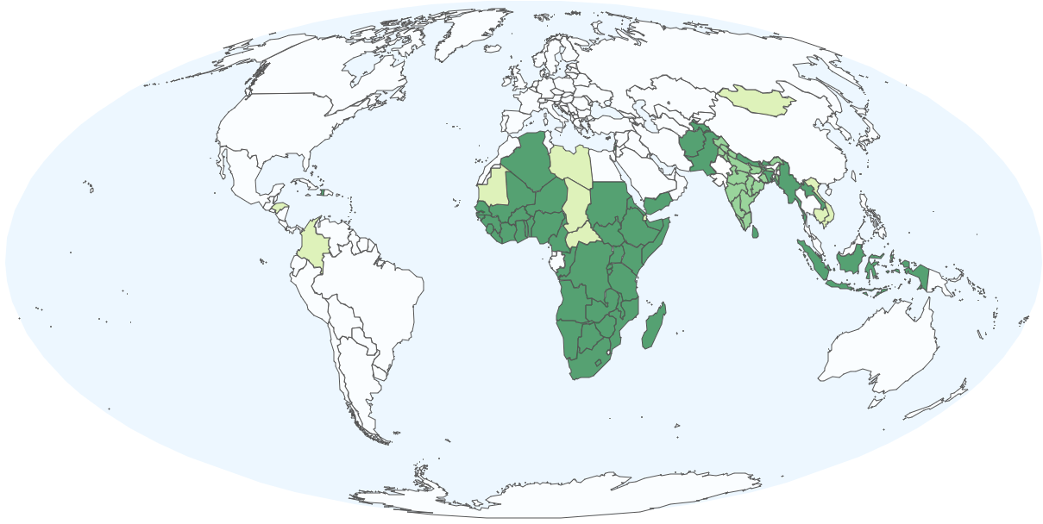
Notes:
Every month, an enormous amount of data is entered into DHIS2 systems around the world.

Slide 4
Capturing data is not enough to make informed decisions
Notes:
However, simply capturing data is not enough to help organizations make informed decisions.

Slide 5





Notes:
To really use your data, you also need tools that help you visualize those data and transform them into information.

Slide 6
How can DHIS2 help make sense of data and contribute to informed decision making?
Notes:
How can DHIS2 help make sense of data and contribute to informed decision making?

Slide 7
Analyze data
Disseminate information
User-friendly applications
Notes:
DHIS2 includes a set of visualization tools that allows you to analyze data and disseminate information through a selection of user friendly applications, making it easier for people at all levels of an organization to use data to make decisions.

Slide 8
Pivot table
Calculate
Summarize
Analyze
Notes:
The first of these tools is the pivot table, which helps you calculate, summarize, and analyze data in rows and columns.

Slide 9
Demo 1
Notes:
In DHIS2, you can customize your pivot tables using a simple drag and drop interface.

Slide 10
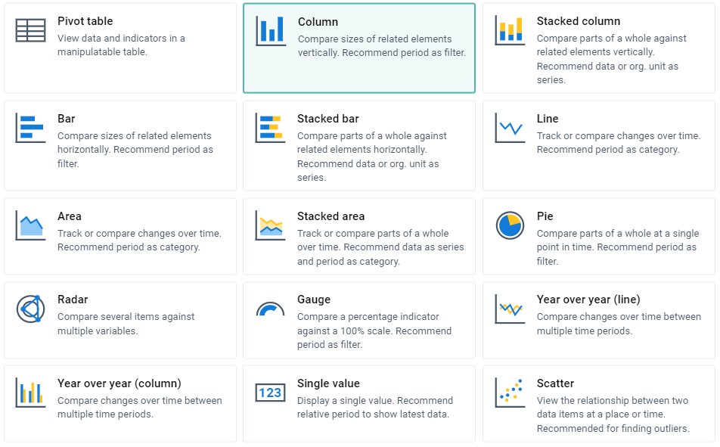
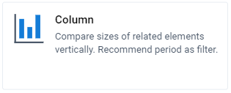
Charts
Disaggregations
Target lines
Compare elements
Other options
Recognize patterns
Understand trends
Notes:
Charts are the second visualization tool in DHIS2. When you need to compare elements, recognize patterns, or understand trends, you can select from a list of different chart types that best suits your analysis needs and customize it to include disaggregations, target lines, and more.

Slide 11
Maps
Relate geographical points with data
Overlay data using map layers
Notes:
The third visualization tool in DHIS2 is Maps, which relate geographical points or areas with specific data from your programs.

Slide 12
Demo 1
Notes:
DHIS2 allows you to overlay data using map layers, providing a greater depth to your analysis.

Slide 13
Notes:
Pivot tables, charts, and maps that belong to the same project or program …

Slide 14
Dashboard
Share
Analyze
Discuss
Notes:
… can be collected into a dashboard and shared with other users to analyze and discuss the findings collaboratively.

Slide 15
In this course, you wil learn…
Pivot tables
Charts
Maps
Dashboards
Videos
Step-by-step demonstrations
Activities
Interact with DHIS2
Notes:
In this course, you will learn how to create and edit pivot tables, charts, maps, and dashboards through videos, step-by-step demonstrations, and activities. You will also have the chance to interact with a DHIS2 training instance where you can put your new learnings into practice.

Slide 16
123
Aggregate
Analyze aggregate data using DHIS2
Notes:
This course will prepare you to make sense of aggregate data using DHIS2 data analysis tools. We hope you enjoy the course.

